Slide 1
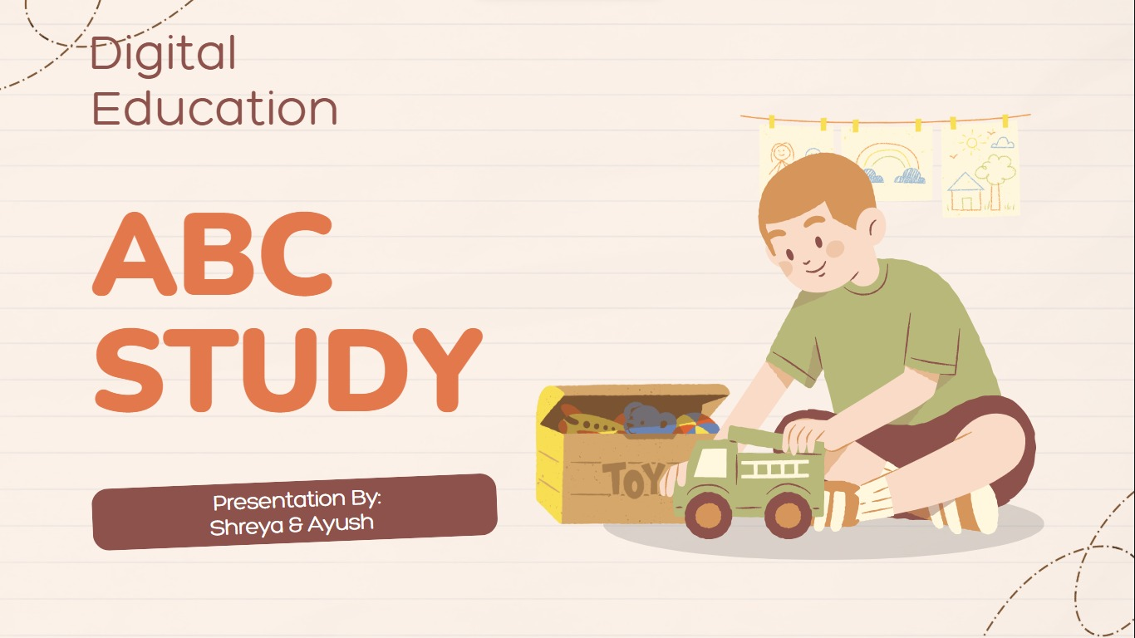

Slide 2
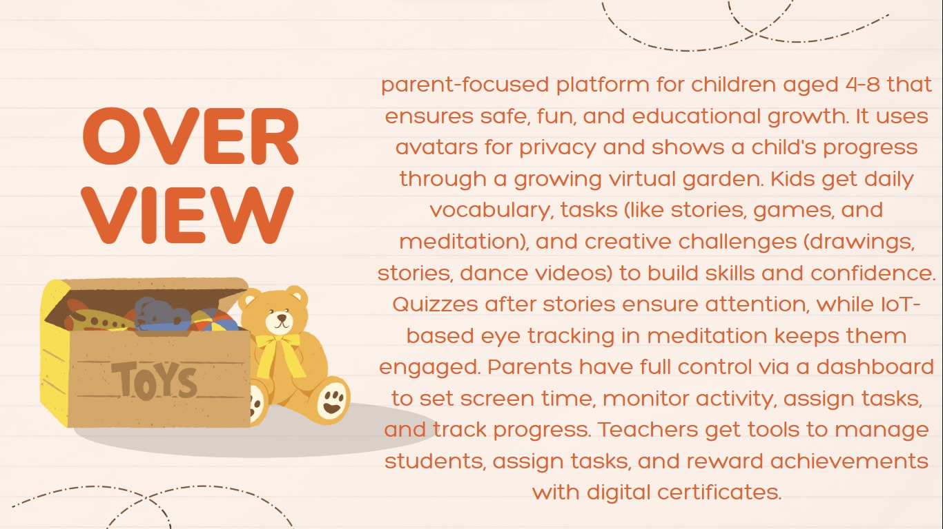

Slide 3
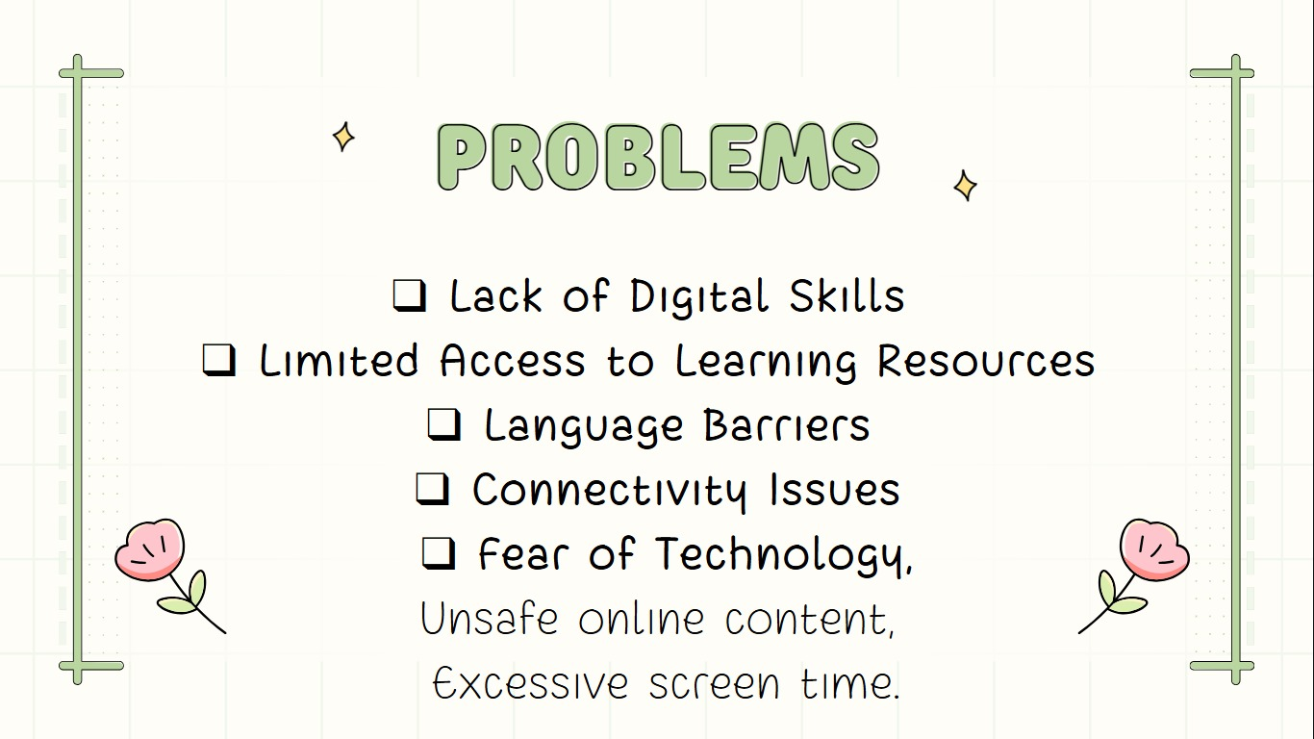

Slide 4

SOLUTION
Child Safety Online – Uses avatars instead of real photos to protect children’s identity.
Distraction-Free Learning – Adds post-task quizzes to ensure kids pay attention during stories or lessons.
Meditation Engagement – Uses IoT eye-tracking to prevent fake participation in meditation sessions.
Customized Learning – Daily tasks and game levels are tailored to each child’s mental ability and age.
Parental Control – Parents can monitor, control screen time, assign tasks, and track child’s progress easily.
Teacher Collaboration – Teachers can assign tasks, manage student performance, and connect with parents.

Slide 5

Uniqueness
Gamified Progress: Kids grow a virtual garden to reflect learning and responsibility.
Talent Showcases: Safe uploads of drawings, dance, and stories to promote creativity.
Reward via Engagement: Unlocks based on likes/views, with review-only feedback.
Parental Insights: Graphs and logs track growth and learning trends.
Healthy Screen Time: Smart time limits (20–90 mins) to balance usage.
Connected Dashboards: Seamless parent-teacher collaboration for child development.

Slide 6
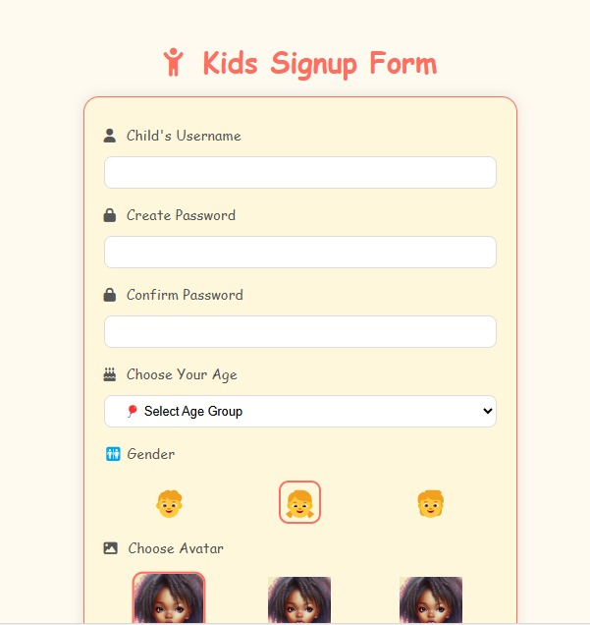
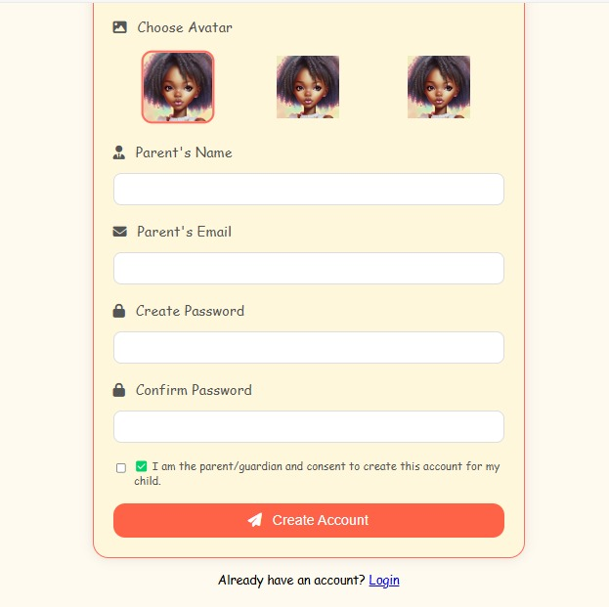
Signup & login page Screenshots

Slide 7
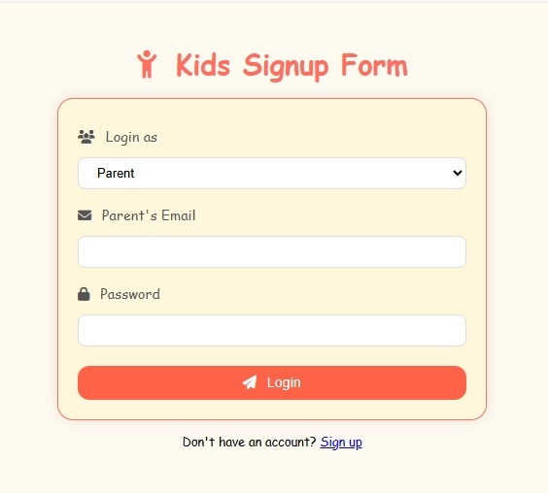
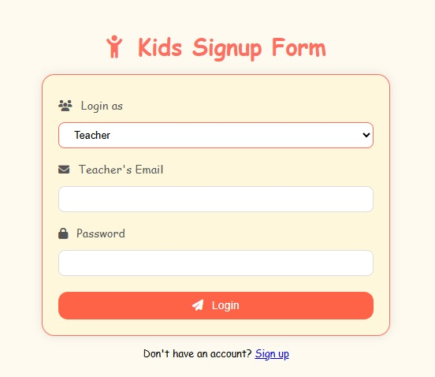

Slide 8
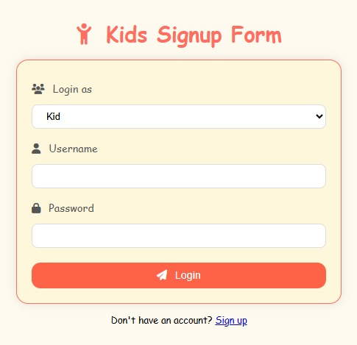
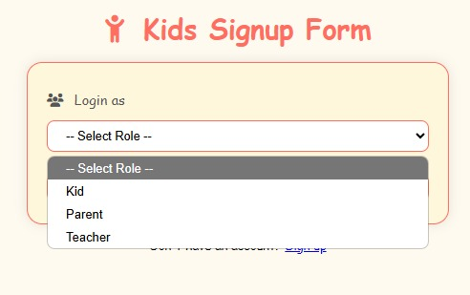

Slide 9
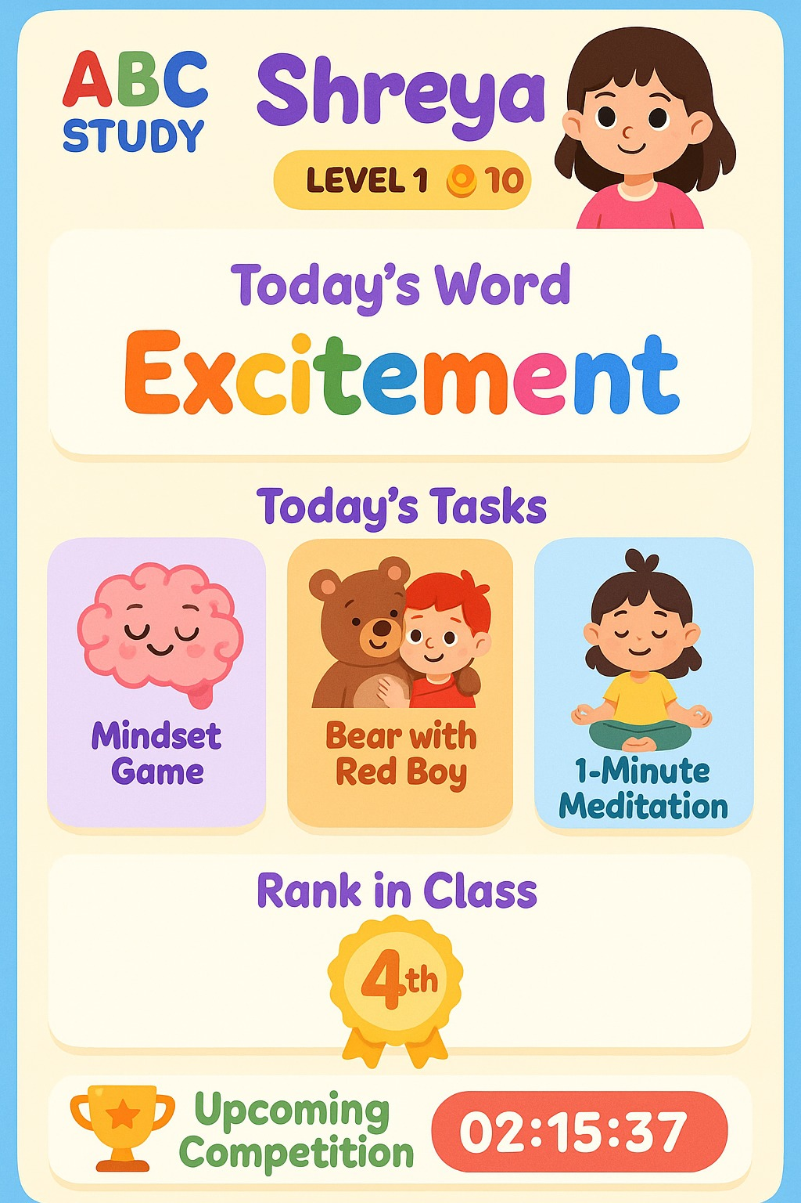
🎮 Child-Friendly Dashboard Includes:
Avatar instead of real photo for safety
Virtual garden that grows with progress
Daily word with synonym & antonym
Fun learning tasks: games, stories, meditation
Rank system to encourage healthy competition
🌟 Talent + Rewards = Motivation
Upload drawing, story, or dance videos
Public views & likes (only review-based feedback)
Rewards like coupons, unlock new games/stories

Slide 10
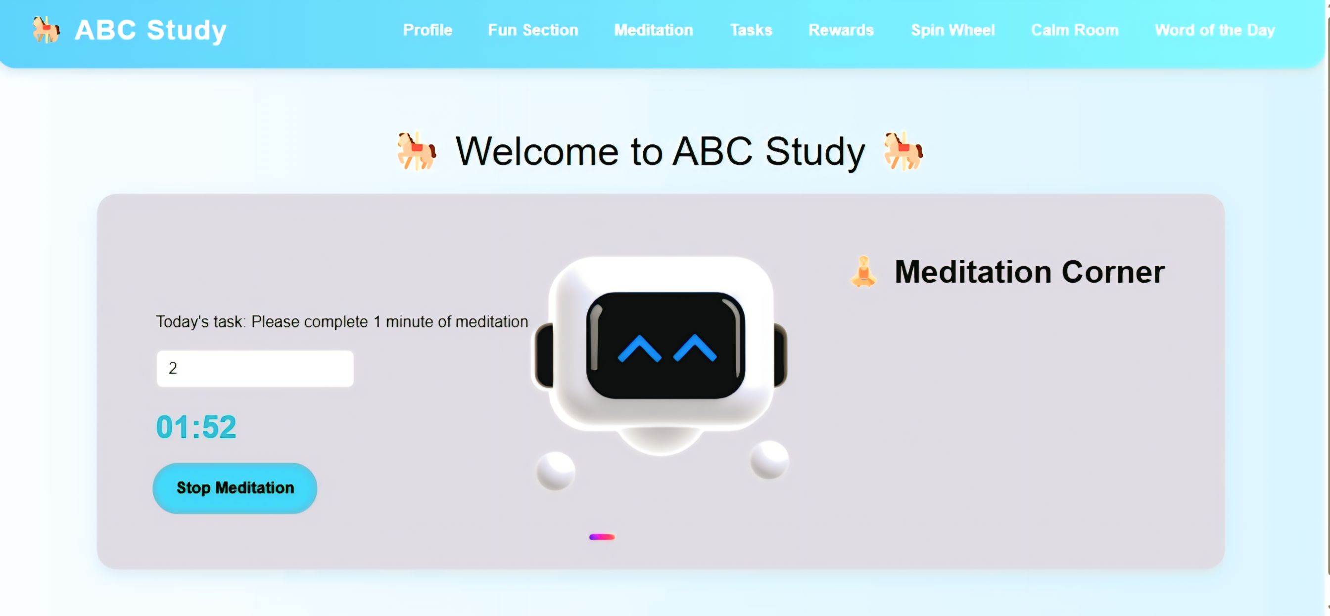

Slide 11
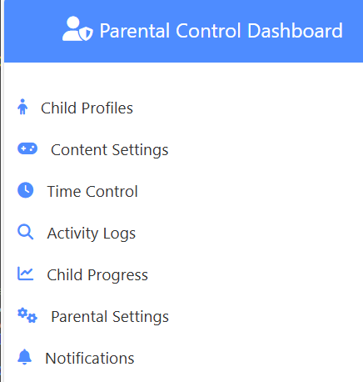
👨‍👩 Parental Control Tools
Manage content, assign tasks
Set screen time (20–90 min/day)
View activity logs & child growth graphs
Get suggestions based on child’s learning pattern

Slide 12
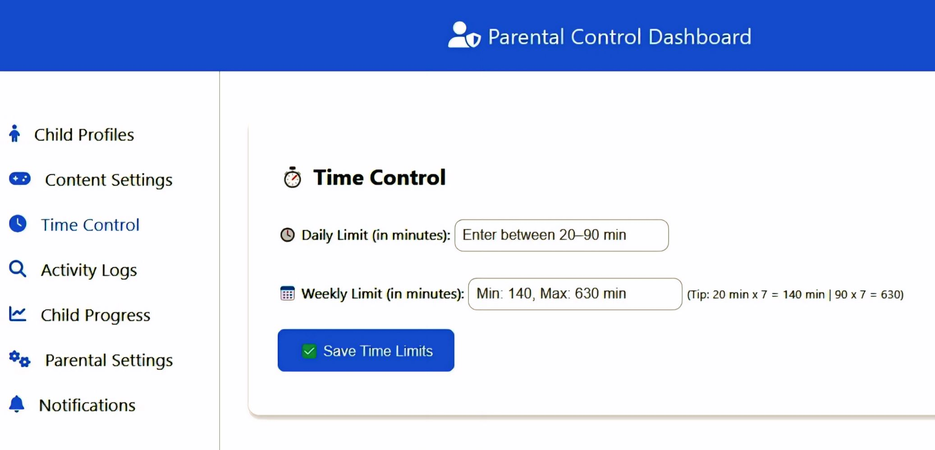

Slide 13
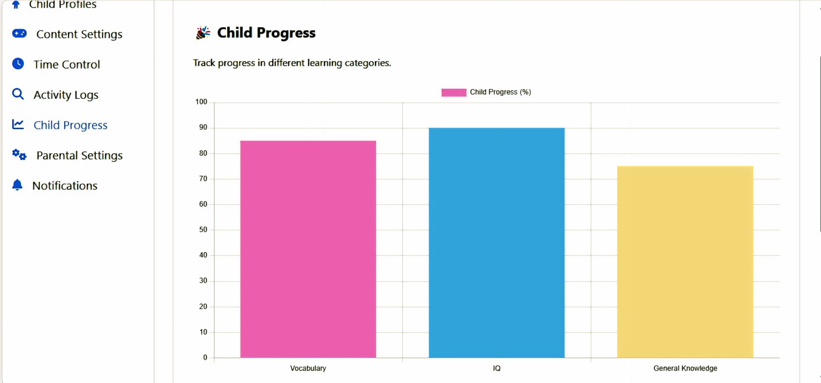

Slide 14
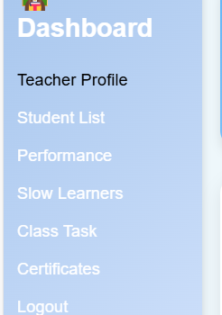
Teacher Dashboard
👩‍🏫 Teacher Features
Add/Remove students
Class performance ranking & progress
Assign custom tasks to slow learners
Send certificates & rewards to top performers

Slide 15
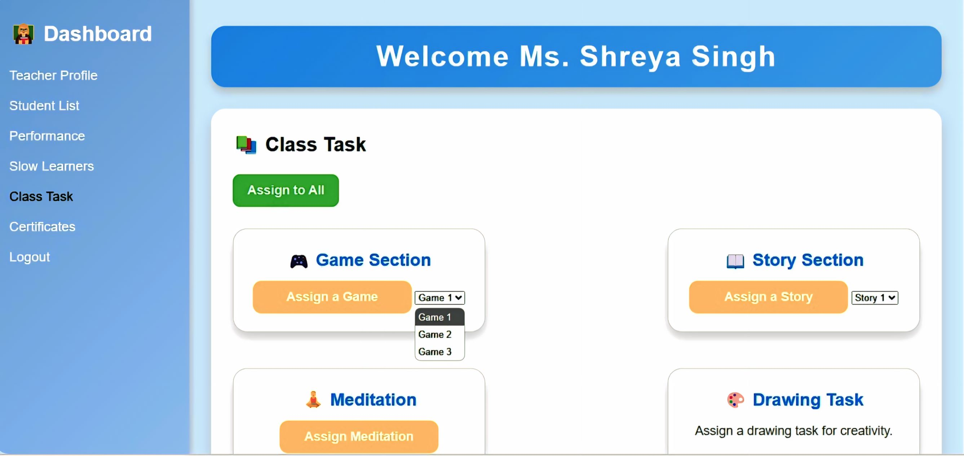

Slide 16
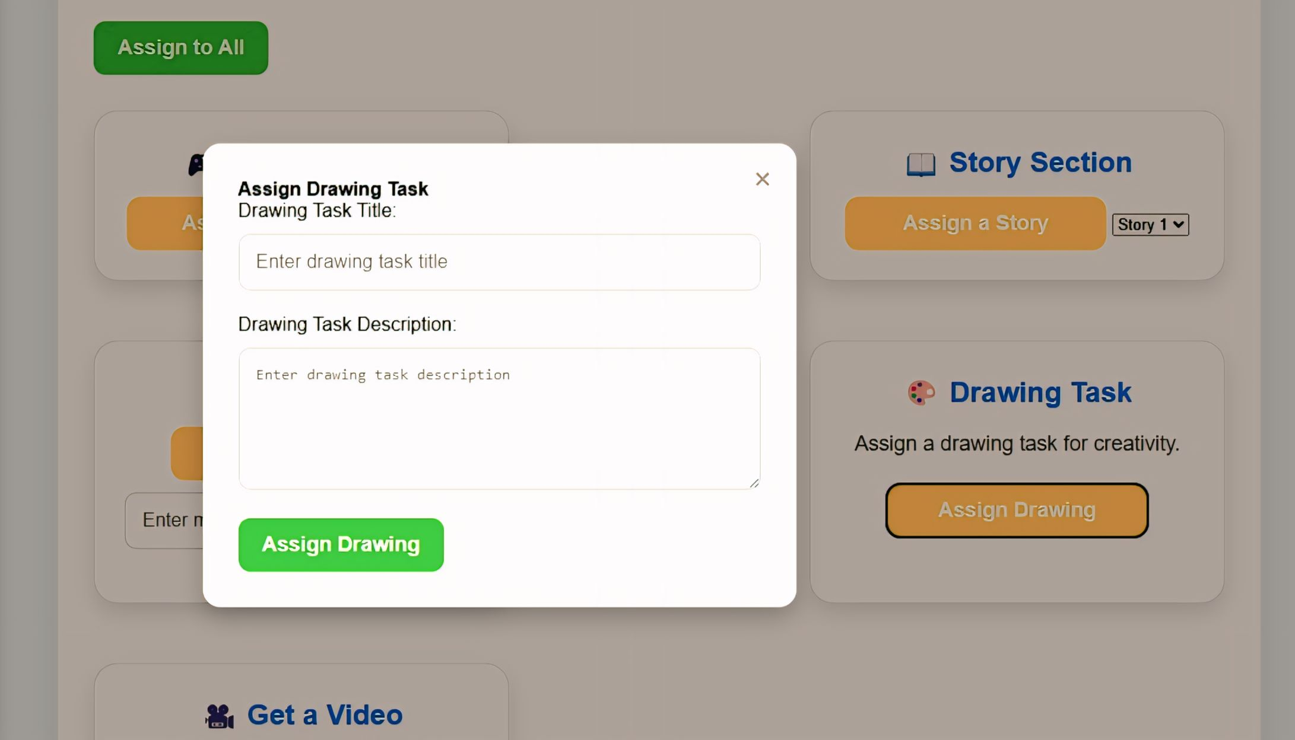

Slide 17

Foundational Education in India (Ages 3–8)
.
.

Slide 18
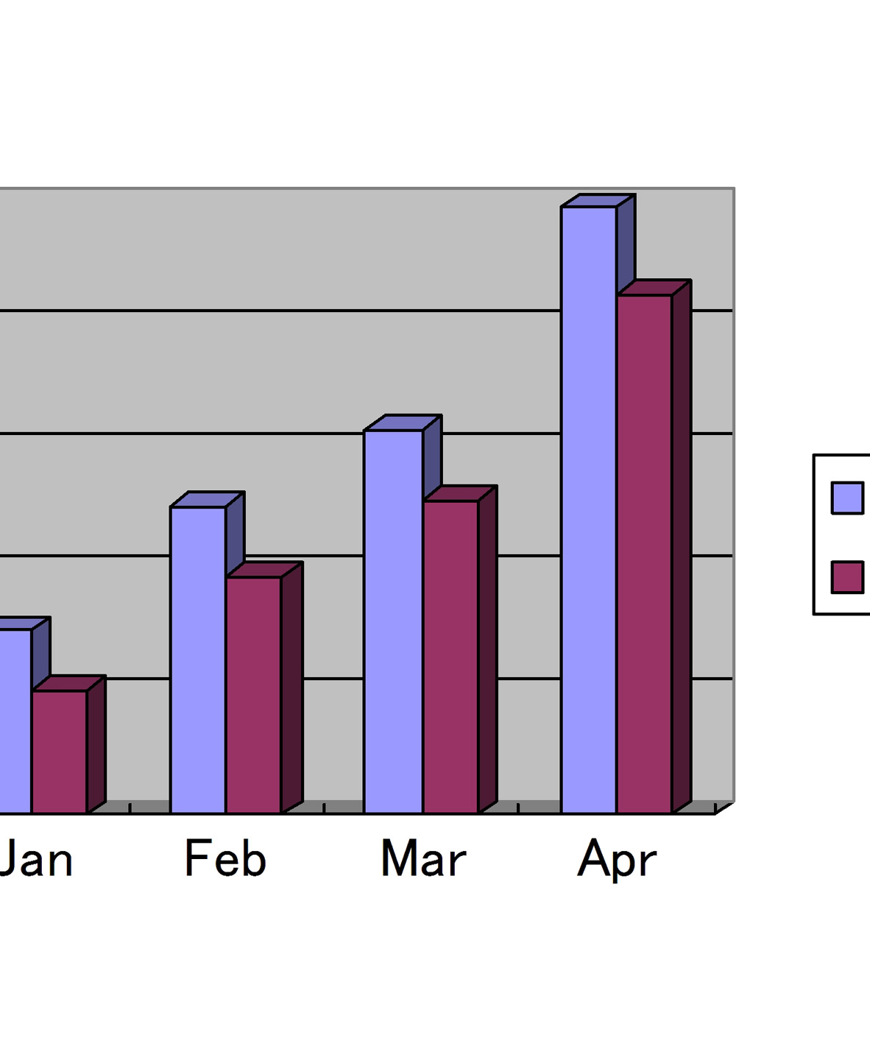
Literacy Rates in Indian States
Literacy Rates – A Comparative View Content: Insert the table:
.
State | Literacy Rate (%) | Source
Kerala | 94.00% | India Census
Uttarakhand | 78.82% | India Census
Odisha | 72.87% | Kampuspedia
Bihar | 79.70% | Times of India
Maharashtra | 82.34% | Census2011.co.in

Slide 19

Global & Indian Screen-Time Data
Screen Time Habits – Global Comparison
.
Spain:
66% kids watch TV during meals
33% use phones/tablets during eating
India (Chandigarh):
59.5% kids aged 2–5 had screen time
77% watched non-educational content during meals

Slide 20

Market & Opportunity
Target Market:
• 50 million learners across regions with high mobile penetration and active community networks. • Initial focus on states like Uttar Pradesh, Bihar, Madhya Pradesh, and Rajasthan. • Research Insights (Primary/Secondary Data): • Primary Data: Community surveys revealed 70% of respondents want to learn digital payments and online services. • Secondary Data: According to the National Digital Literacy Mission (NDLM), less than 30% of rural households are digitally literate.
Total Addressable Market:
• 500+ million rural Indians who need essential digital skills. • Includes farmers, small business owners, students, and homemakers

Slide 21
Business Model
1. Source of Revenue:
❑ Government Partnerships: Collaborate with state and central government programs for rural digital literacy. ❑ Revenue Source: Service contracts, grants, and subsidies for implementing training programs. ❑ Subscription-Based Learning: Freemium model: Basic modules are free; advanced content requires a low-cost subscription. ❑ Target Audience: Rural businesses, self-help groups, and individuals seeking advanced skills. ❑ Corporate CSR Collaborations: Partner with corporations under their Corporate Social Responsibility (CSR) initiatives. Revenue Source: Sponsored programs and co-branded digital literacy campaigns. ❑ Educational Institutions & NGOs: Licensing the platform to NGOs and educational organizations for community-based training. ❑ Revenue Source: Training fees and content licensing agreements.

Slide 22

2. Revenue Timeline:
Phase | Timeline | Key Activities | Revenue Expectation
Phase 1 | Year 1 | Pilot launch, partnerships with 3 states, & CSR outreach. | ₹10–15 lakh
Phase 2 | Year 2 | Expand to 5+ states, introduce paid content. | ₹30–40 lakh
Phase 3 | Year 3 | National expansion with new content streams. | ₹75 lakh – ₹1 crore
Phase 4 | Year 4+ | Diversify offerings (agriculture-tech literacy, fintech). | ₹1.5 crore+

Slide 23

Q&A
.

Slide 24

Thank you
SHREYA SINGH
AYUSH
Tech Titans

